Slide 1
Lesson Eighteen Questions
May 18, 2022

Slide 2
Bartimaeus and His Companion Healed.
(Matthew 20:29-34; Mark 10:46-52; Luke 18:35-43)
What miracle did Jesus perform on Bartimaeus and another man? What were the results of this miracle?

Slide 3
Zacchaeus. The Parable of the Pounds. Journey to Jerusalem. (Luke 19:1-28)
Who was Zacchaeus? How did Jesus meet him?
What request did Jesus make to Zacchaeus? How did he respond?
Why, according to His statement in verse ten, did Jesus come to earth? Explain what He meant.
Briefly summarize the parable of the pounds. What lesson does it teach? What application, if any, can be made of its teaching today?

Slide 4
Lesson 19 - The Last Week Of Jesus’ Life (I)
Triumphant Entry Into Jerusalem
Matthew 21:1-11, 14-17; Mark 11:1-11;
Luke 19:29-44; John 12:12-19
May 18, 2022

Slide 5
The Journey To Jerusalem
Came From Galilee.
Samaritans refused Jesus. Luke 9:51ff
  Jesus healed a Samaritan. Luke 17:11-13
Came to Jericho.
  Healed two blind men. Matthew 20:29-34;
  Mark 10:46-52; Luke 18:35
  Visited with Zacchaeus. Luke 19:10
Came to Bethany.
  Rested on the Sabbath. John 12:1
  Had supper with Martha, Mary, and Lazarus.
  John 12:2-8
  Common people heard him. John 12:9
  Chief priests desire to kill Lazarus. John 12:10-11;
  cf. John 11:56-57

Slide 6
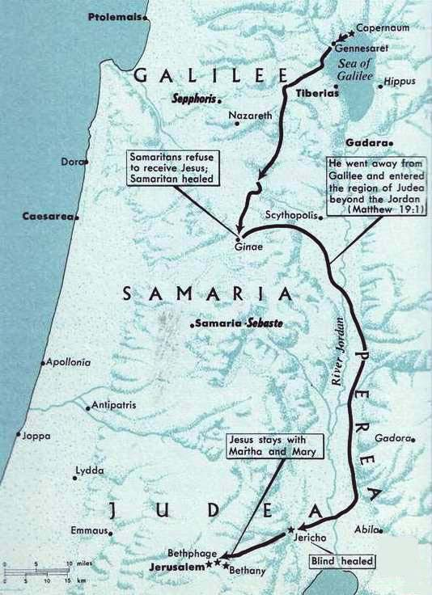
The Journey To Jerusalem
Crossed into the region beyond Jordan. Matthew 19:1
Samaritans refuse to receive Jesus.
Matthew 19:1
Samaritan Healed. Luke 17:11
Stopped in Bethany.
Rested on the Sabbath day.
John 12:1
Healed two blind men, visited Zacchaeus.
Luke 18:35-19:10
About 1,200 feet below sea level.

